Slide 1
OFFICIAL DRESS CODE GUIDELINES
Ensuring a professional and stylish atmosphere for all participants and spectators
By: GM Ahmed Adly
Chairman - FIDE Athletes Commission

Slide 2
01
Dress to Impress: Elevate the Game
At the FIDE World Rapid & Blitz Championships, we encourage players, officials, and staff to embrace a dress code that
reflects the prestige and elegance of this global chess event. It's about creating a positive and inspiring image for chess,
showcasing a level of professionalism that aligns with the high caliber of competition.
Project an Image of Excellence
Showcase Respect and Unity
A polished appearance conveys seriousness and respect for the game, setting the tone for a focused and engaging tournament experience. It helps elevate the overall atmosphere, creating a dignified and memorable event.
The dress code promotes a sense of camaraderie and mutual respect among participants, creating a more unified and cohesive environment where everyone feels equally valued and part of the chess community

Slide 3
02
Who Should Adhere to the Dress Code?
The dress code applies to all individuals participating in the FIDE World Rapid & Blitz Championships, ensuring a consistent and professional look across the entire event. This includes:
Players
Officials
Representatives
All participating players, showcasing their commitment to the game and its image.
FIDE officials, arbiters, and staff, representing the authority and integrity of the organization.
FIDE representatives attending the event, upholding a professional standard for the organization's public image.

Slide 4
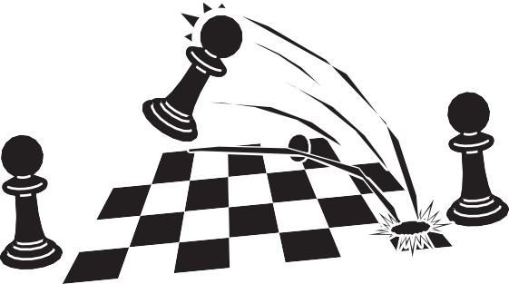
03
Smart Business Attire: The Standard for Excellence
The dress code for the playing venue is Smart Business Attire, aiming for a balance between professionalism and comfort. This allows for individual expression while maintaining a consistent level of elegance.
1
Men
2
Women
Suits, trousers, long-sleeve or short-sleeve shirts, polo-shirts, shoes, loafers, jackets, vests, sweaters, or national traditional dress (with prior approval from the FIDE Technical Delegate).
Suits, dresses, skirts, blouses, turtlenecks, shirts or polos, trousers or slacks, jackets, vests, sweaters, scarves, footwear (boots, flats, mid-heel or high-heel shoes), and jewelry (earrings, necklaces, etc.), as well as national costumes clothing (with prior approval from the FIDE Technical Delegate).

Slide 5
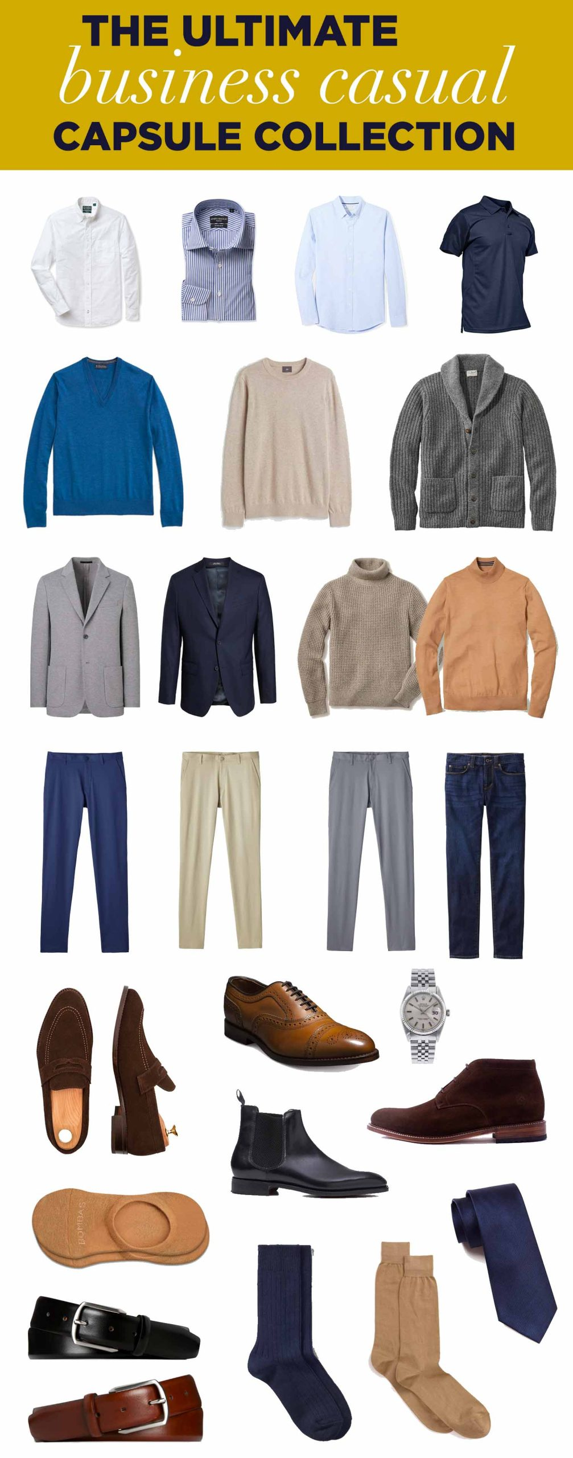
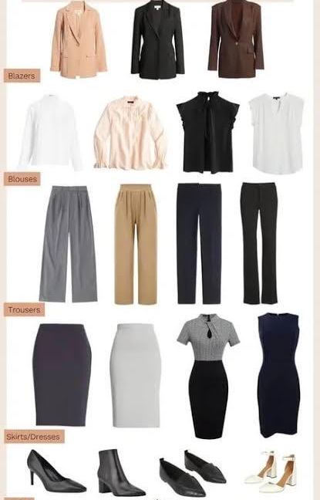
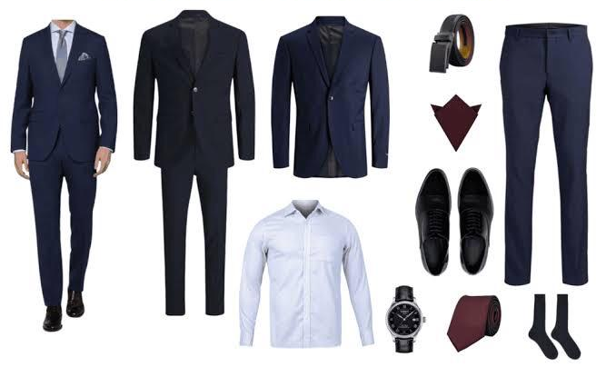
04
Guiding Samples of Approved Outfits !!
DRESS FOR CHESS TO IMPRESS
* Dress up what fits you the most , These photos are guidelines examples !

Slide 6
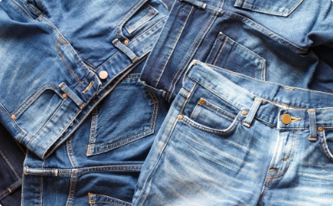
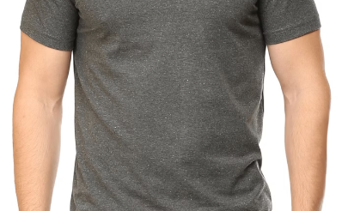
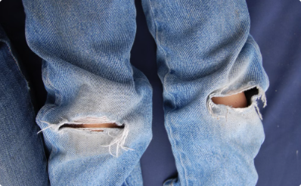
05
What's NOT Allowed? Avoiding Unprofessional Attire
Sneakers “all styles”
Jeans
T-Shirts
Torn Clothing
Avoid athletic footwear and opt for more formal shoe options.
Jeans are generally not considered business attire.
For men, choose collared shirts or polo shirts. For women, consider blouses, dresses, or more formal T-shirts.
Ensure that all clothing is in good condition and clean.
To maintain the high standards of the FIDE World Rapid & Blitz Championships, certain attire is considered inappropriate for the playing venue.

Slide 7
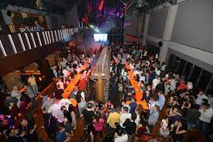
06
Beyond the Playing Venue: Relaxed Dress Code
Outside the playing venue, the dress code is relaxed, allowing for more casual attire. However, remember to maintain a respectful and appropriate appearance.
Enjoy your time at the FIDE World Rapid & Blitz Championships, celebrating the game and making lasting memories.

Slide 8
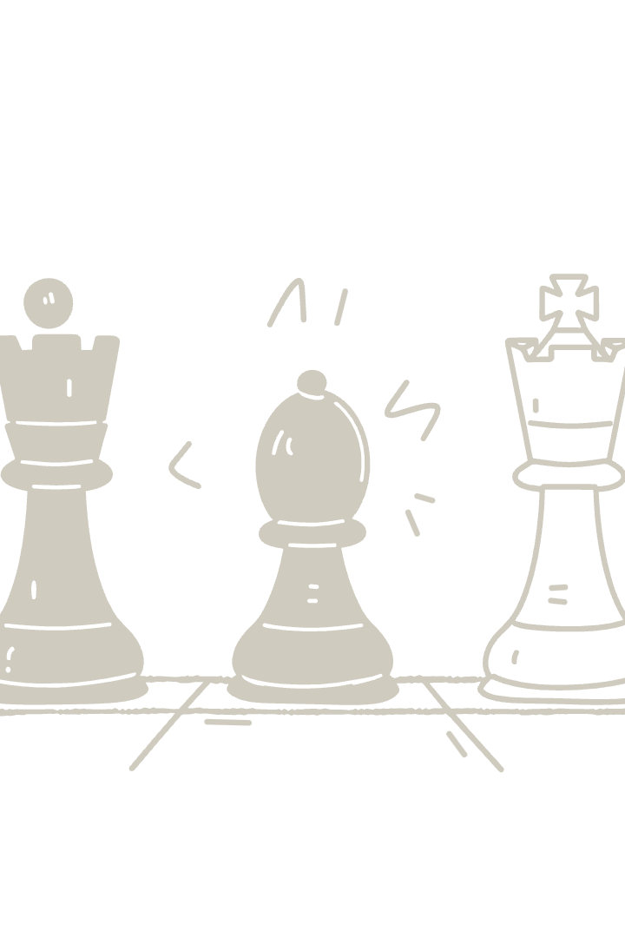
07
Enforcing the Dress Code: Ensuring Fair Play
The dress code is strictly enforced to maintain a consistent level of professionalism and respect for the event. The Chief Arbiter, in consultation with the FIDE Athletes Commission, will ensure that the dress code is upheld.
First Infringement
A financial penalty of 200 € for open events and 100 € for women's events. The player is allowed to play the current round.
Further Infringements
Exclusion from the pairings for the next round. Each round counts as one infringement.

Slide 9
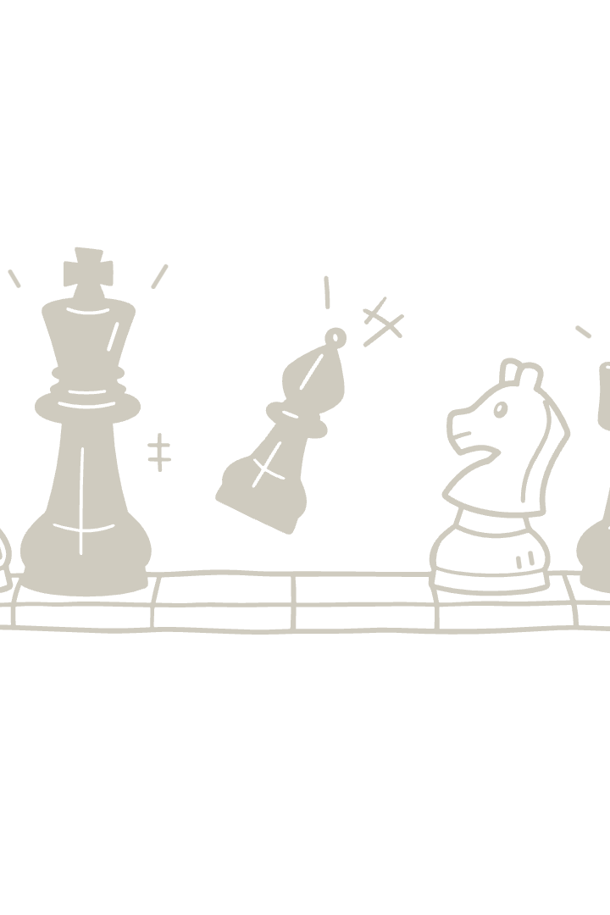
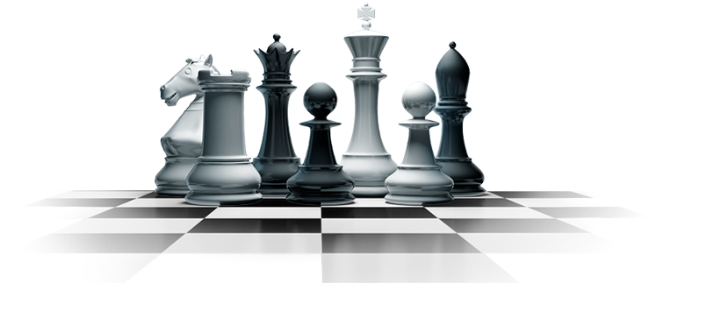
08
Embrace the Spirit of Chess: A Celebration of Excellence
The FIDE World Rapid & Blitz Championships is a celebration of chess, a game of strategy, intellect, and sportsmanship. Let's come together to create an atmosphere that reflects the high caliber of play and the spirit of this remarkable game.
Respectful Attire
Professionalism
Positive Image
Consistent Standards
Fair Play
Memorable Experience

Slide 10
09
FIDE: Leading the Way in Chess Excellence
FIDE, the International Chess Federation, is dedicated to promoting and developing
chess globally. The FIDE World Rapid & Blitz Championships is a pinnacle event that
showcases the best of chess talent worldwide.
Prestige
Global Reach
Strategic Vision
The championship is a prestigious event, attracting top players from around the globe.
The event has a global reach, uniting chess enthusiasts from diverse cultures and backgrounds.
FIDE's vision is to guide the development of chess on a global scale, promoting its educational and social benefits.

